Slide 1
金融市場與金融機構
蔡政憲(Jason; 憲哥）
政治大學商學院風險管理與保險學系

Slide 2
財務金融是在講什麼？
從談公司的理財（Corporate Finance; Financial Management）出發，畢竟公司是驅動整個經濟體系的源頭

Slide 3
The Firm and the Financial Markets
Firm issues securities (A)
Financial
Markets, Institutions, and Intermediaries
Firm
Invests
in real assets
(B)
Retained
cash flows (F)
Cash flow
from firm (C)
Dividends and
debt payments (E)
Short-term debt
Long-term debt
Equity shares
Taxes (D)
Government

Slide 4
Investment and Financing Decisions
Company (revenue in billions for 2007 or 2008) | Recent Investment Decision | Recent Financing Decision
Boeing ($61 billion) | Began production of its 787 Dreamliner aircraft, at a forecast cost of more than $10 billion. | The cash flow from Boeing’s operations allowed it to repay some of its debt and repurchase $2.8 billion of stock.
Wal-Mart ($379billion) | In 2008 announced plans to invest over a billion dollars in 90 new stores in . | In 2008 raised $2.5 billion by an issue of 5-year and 30-year bonds.
LVMH (€17 billion ) | Acquired the Spanish winery, Bodega Numanthia Termes. | Issued a 6-year bond in 2007, raising 300 million Swiss francs.
Lenovo ($16 billion) | Expanded its chain of retail stores to cover over 2,000 cities. | Borrowed $400 million for 5 years from a group of banks

Slide 5
The Flow of Savings to Corporations
Financial Markets
Stock markets
Fixed-income markets
Money markets
Corporation
Investment in real assets
Investors
(worldwide)
Financial Institutions
Banks
Insurance Companies
Financial Intermediaries
Mutual Funds
Pension Funds

Slide 6
Financial Markets
Investors
Stocks and Bonds
Firms
securities
Money
Bob
Sue
money
Primary Market
Secondary Market

Slide 7
Other Financial Markets
Foreign exchange markets
Commodities markets
Markets for options and other derivatives

Slide 8
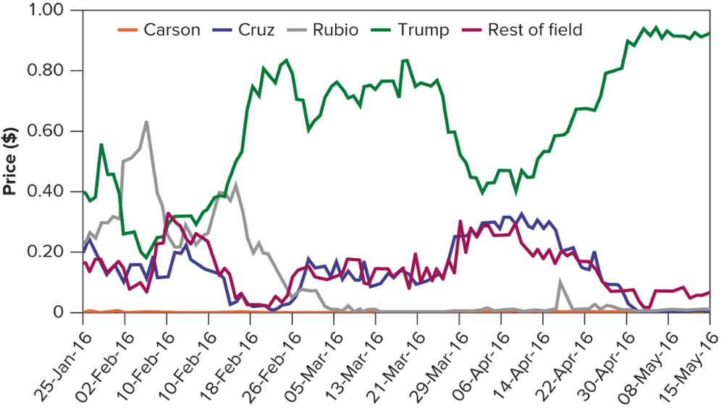
2016 U.S. Republican Convention Nomination Market
Source: Iowa Electronic Markets: Iowa Electronic Markets

Slide 9
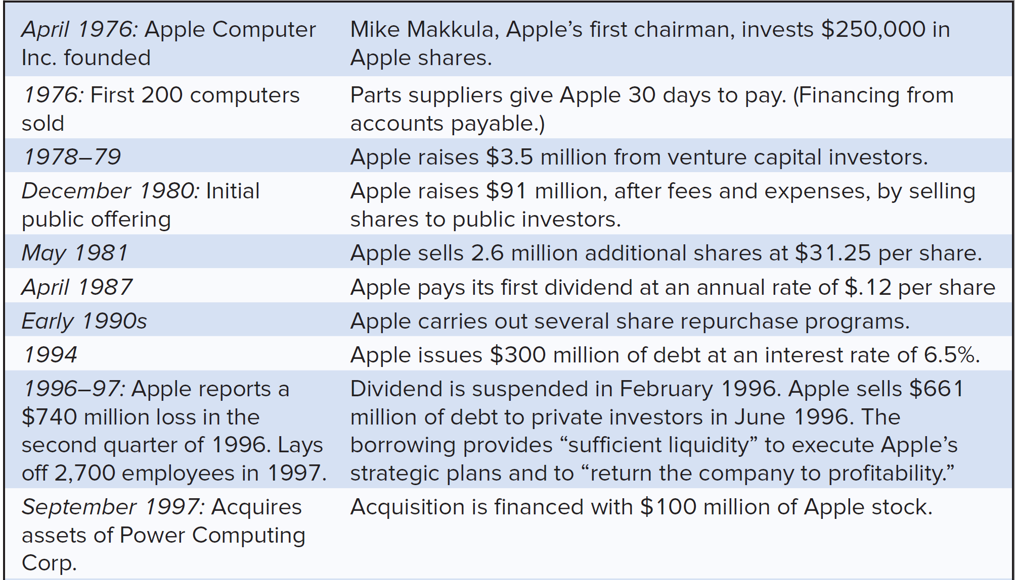
Examples of financing decisions by Apple Computer
Notes:
6
5
5
5
5
5

Slide 10
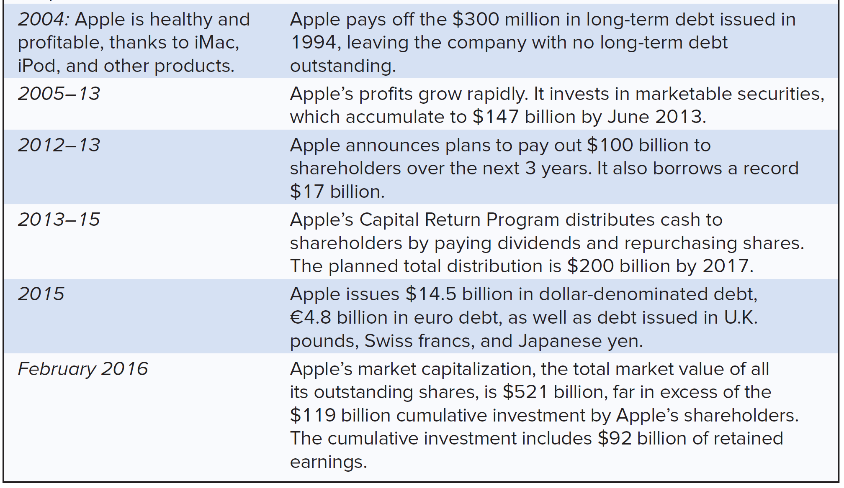
Examples of financing decisions by Apple Computer (continued)
Notes:
6
5
5
5
5
5

Slide 11
Financial Institutions and Intermediaries
Company
Obligations
Funds
Banks
Insurance Cos.
Brokerage Firms
Intermediary/
Institutions
Obligations
Funds
Depositors
Policyholders
Investors
Investor
Notes:
16
15
8
8
8
8

Slide 12
Financial Intermediaries
Mutual Fund
  An investment company that pools the savings of many investors and invests in a portfolio of securities
Hedge Fund
  A private investment pool, open to wealthy or institutional investors, that is only lightly regulated and therefore can pursue more speculative policies than mutual funds
Pension Fund
  Fund set up by an employer to provide for employees’ retirement
Notes:
12
11
7
7
7
7
Financial Intermediary – An organization that raises money from investors and provides financing for individuals, corporations, or other organizations
Mutual Fund – An investment company that pools the savings of many investors and invests in a portfolio of securities
Hedge Fund – A private investment pool, open to wealthy or institutional investors, that is only lightly regulated and therefore can pursue more speculative policies than mutual funds
Pension Fund – Fund set up by an employer to provide for employees’ retirement

Slide 13
Financial Institutions
Commercial Banks and Other Depository Institutions
Insurance Companies
Investment Banks
  Underwriting
  Investing in start-ups
  Facilitating takeovers, mergers, and acquisitions

Slide 14
要怎麼做決策才能賺錢？
要記得金錢有時間價值

Slide 15
Interest Rates and the Time Value of Money
Consider an investment opportunity with the following certain cash flows.
  Cost: $100,000 today
  Benefit: $105,000 in one year
Notes:
A case of DRC

Slide 16
The Interest Rate:
An Exchange Rate Across Time
Suppose the current annual interest rate is 7%. By investing or borrowing at this rate, we can exchange $1.07 in one year for each $1 today.

Slide 17
The Interest Rate:
An Exchange Rate Across Time (cont'd)
Value of Investment in One Year
  If the interest rate is 7%, then we can express our costs as:
  Cost = ($100,000 today) × (1.07 $ in one year/$ today)
  = $107,000 in one year

Slide 18
The Interest Rate: An Exchange Rate Across Time (cont'd)
Value of Investment in One Year
  Both costs and benefits are now in terms of “dollars in one year,” so we can compare them and compute the investment’s net value:
  $105,000 − $107,000 = −$2000 in one year
  In other words, we could earn $2000 more in one year by putting our $100,000 in the bank rather than making this investment. We should reject the investment.

Slide 19
要善用金錢的時間價值
以錢滾錢

Slide 20
要怎麼做決策才能賺錢？
要記得金錢有時間價值
要記得風險和報酬息息相關，並做完全的風險分散

Slide 21
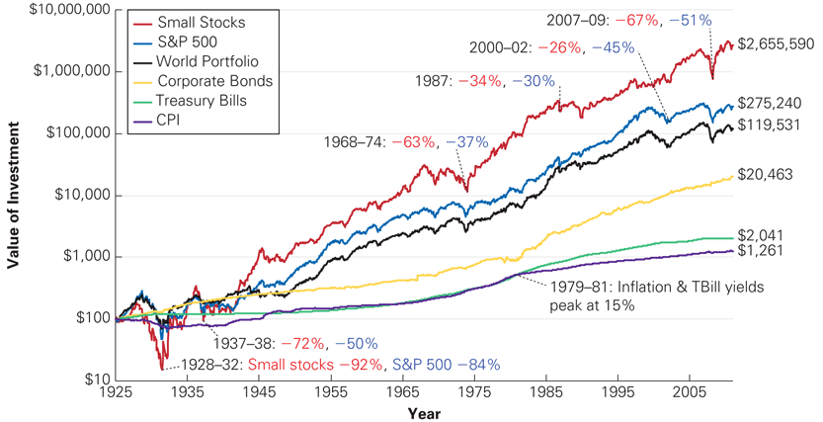
Value of $100 Invested at the End of 1925
Source: Chicago Center for Research in Security Prices, Standard and Poor’s, MSCI, and Global Financial Data.

Slide 22
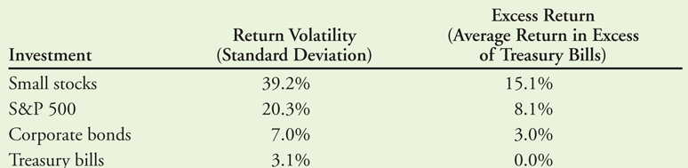
Volatility Versus Excess Return of U.S. Small Stocks, Large Stocks (S&P 500), Corporate Bonds, and Treasury Bills, 1926–2011

Slide 23
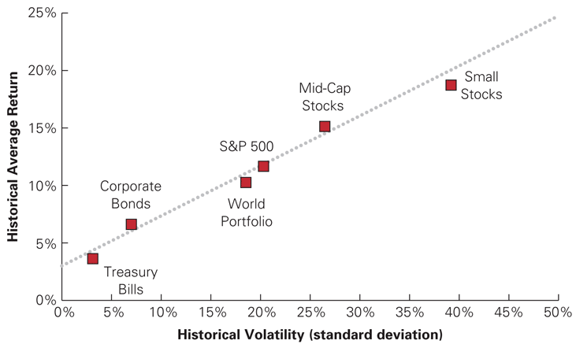
The Historical Tradeoff Between Risk and Return in Large Portfolios
Source: CRSP, Morgan Stanley Capital International

Slide 24
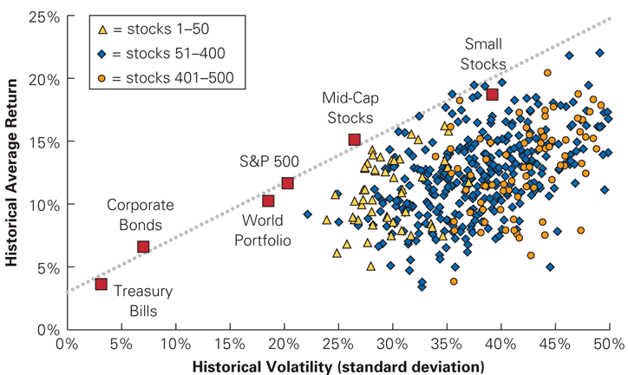
Historical Volatility and Return for 500 Individual Stocks, Ranked Annually by Size

Slide 25
要怎麼做決策才能賺錢？
要記得金錢有時間價值
要記得風險和報酬息息相關，並做完全的風險分散
要記得大家都跟你一樣想賺錢，並承認無法預測未來
  很難擊敗大盤
  Superstars?

Slide 26
An Experiment
Coin Toss Game
Heads
$106.09
Heads
$103.00
$100.43
Tails
$100.00
Heads
$100.43
$97.50
Tails
$95.06
Tails

Slide 27
An Experiment

Slide 28
An Experiment

Slide 29
如何在金融市場或金融機構發展成功的生涯
根據人格特質選擇領域，然後培養專業知識
人際關係（對上、對平輩、對下）
溝通與表達能力
領導統御
見識/格局
品格（Character）

